Slide 1
Youtube Automatic Sentiment Analysis (YASA)
Natural Language Processing Project
Amr El-Gendy Mohamed Maher

Slide 2

Outline
Introduction and Project Statement
Methodology
Datasets
Roles
Results
Conclusion & Further Improvements
Acknowledgment
References

Slide 3

Introduction To (YASA)
Project Statement
Insightful Ideas:
- Connect to a well-known API like YouTube in order to collect data. - Performing pre-processing steps on data obtained for analysis. - Dealing with different languages and finding a solution to Arabizi Language. - Performing Hybrid Technique for text classification (Lexicon – Dataset) Approaches. - Making Scripts as Micro Services & Deployment as a web application on cloud computing service.

Slide 4
Methodology
Eg: YouTube Api
2.Extractor
(PHP)
3.Analyzer
(Python)
(Micro Service)
Comments
Results(JSON)
Model + Features ( Ar/En)
Labeled Dataset
1.Model Builder
(Python)
Offline
Stop Words
Negation Words
ML Algorithm

Slide 5
Model Extractor (Offline Function)
1.Model Builder
Offline
Input:
Labeled Dataset for several comments in all languages used.
“El ragel dh by2ol klam ze el fl” → +1
“ممكن تسويلي صبصقرايب”→ 0
“I hate watching such movies” → -1
B. Machine Learning Algorithm
2. Processing: divide dataset into (Training / Testing) - (80%- 20%) then try different parameters on selected algorithm until we achieve highest accuracy on testing section. (Naïve Bayes – NN – SVM)
How to choose Features???
TermFreq (TF)
TF-Inverse Document Freq (IDF) → Lower Accuracy

Slide 6
Model Extractor (Offline Function)
1.Model Builder
Offline
Output: Model to used on new comments
Results: best accuracy achieved for: - Arabic Language is 82% on testing set (Emotional Tone Dataset). - 99% for English Language Dataset (Movie Reviews in NLTK). - Using 10k features of highest TF after Normalization of dataset words. - Using DNN with 5 hidden layers and initial states of 1 and learning rate of 1e-5.

Slide 7
2. Extractor
2.Extractor
- Used to fetch comments from a certain API and pass them to the Analyzer API to perform Sentiment Analysis process.
- We will use Youtube API to fetch comments from a youtube video.
- This process is made using PHP instead of Python to facilitate the design process of web application.

Slide 8
3. Analyzer
3.Analyzer
(Micro Service)
Language Detection
Franco Conversion
PreProcessing
Preprocessing: Involves (1)HandWritten Rules - (2)Tokenization - (3)Normalization (4) Franko Conversion
Eg: (1) Replace all ى with ي
(2) I Like This Movie → {“I”, “Like”, “This”, “Movie”}
(3) I felt guilty after watching those movies → i feel guilt after watch movie – (Arabic???) (4) “elfilm dh gamed gdn w momsel 3azym” → الفيلم ده جامد جدا وممثل عظيم (5) Stop Words Removal
LongRun Process

Slide 9
3. Analyzer
3.Analyzer
(Micro Service)
0.35 to 1 = +ve
PreProcessing
Lexicon Approach
Classified
-0.35 to -1 = -ve
-0.1 to 0.1 =neutral
Lexicon Approach:
We have a labeled lexicon where each word as a certain weight. (Eg: love = 1, hate = -1).
Weight of Word = (No. of times as Positive word in Lexicon – No. of times as Negative) / Total number of existance in lexicon. (eg. الله يكرمك – الله يخرب بيتك)
Inverse Weight of words preceded by negation words (eg. I never like such movies)
Dataset Approach

Slide 10
3. Analyzer
3.Analyzer
(Micro Service)
0.35 to 1 = +ve
PreProcessing
Lexicon Approach
Classified
-0.35 to -1 = -ve
-0.1 to 0.1 =neutral
Lexicon Approach:
Calculate total weight from tokens of the comment and normalize it so we would have a value from +1 to -1 to detect the semantic of the comment.
If weight of comment > |0.35| or less than |0.1| then we are almost sure of its class.
Uncertain comments can be classified using the Model built before (DataSet Approach).
Dataset Approach

Slide 11
3. Analyzer
3.Analyzer
(Micro Service)
Lexicon Approach
Supervised Model Approach
Results (JSON)
Supervised Model Approach:
Use Model we have built before in offline “Builder” function to classify the comment.

Slide 12

Technique in Points:
Using YouTube API to retrieve certain number of comments from a Video URL.
Detect Language of Comment.
Converting Arabizi comments into Arabic Language.
Preprocessing: Tokenization & Normalization of Each Comment to get a word features vector for each comment.
Detect Stop & Negation Words.

Slide 13
Technique in Points:
6) Using Lexicon Approach.
7) Converting weight of words preceded by Negation.
8) Normalization of total weight of comment (+1 = positive comment, -1 = negative comment, 0 = neutral).
9) Building a model using DNN (Dataset Approach).

Slide 14
Technique in Points:
10) Using labeled datasets in Supervised approach to make sure about comments of intermediate weight.
11) Application Deployment.
12) Collecting and Display Results.

Slide 15
Datasets
I) Offline Builder: “English Movie Reviews” in NLTK corpus “Emotional Tone” Dataset in Arabic
II) Analyzer: “Hu and Liu” Lexicon for English words “NilULex” lexicon for Arabic words

Slide 16
Role of Each Member
1) Amr El-Gendy:
Using YouTube API
Data Preprocessing (Language Detection/Conversion – Tokenization and Normalization)
Building Lexicon Approach.
2) Mohamed Maher:
Supervised approach by Building a Model from Labeled Datasets
Application Integration and Collecting results
Application Deployment

Slide 17

Results

Slide 18
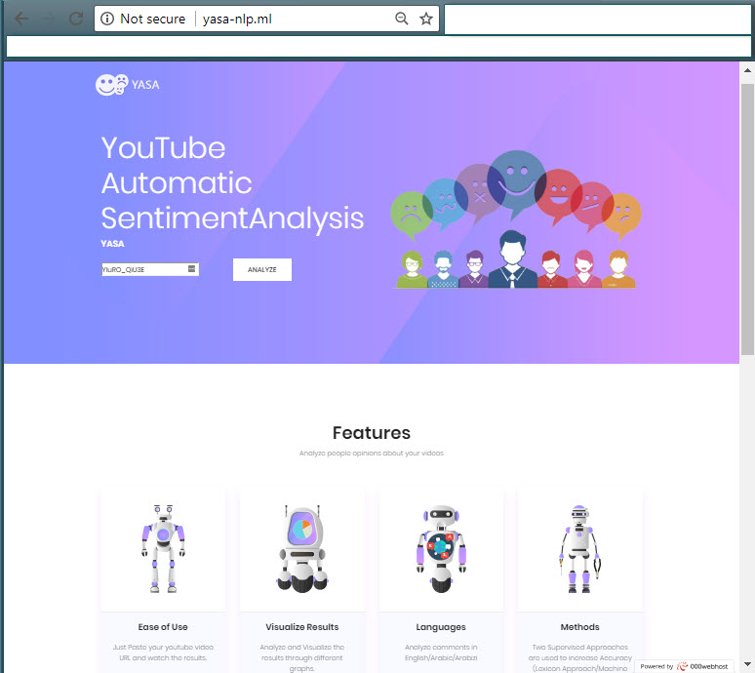
www.yasa-nlp.ml
Website for our project (automation of YouTube videos Sentiment Analysis.)
Just Enter Video ID and Maximum number of comments to retrieve then Analyze and wait for the results.

Slide 19
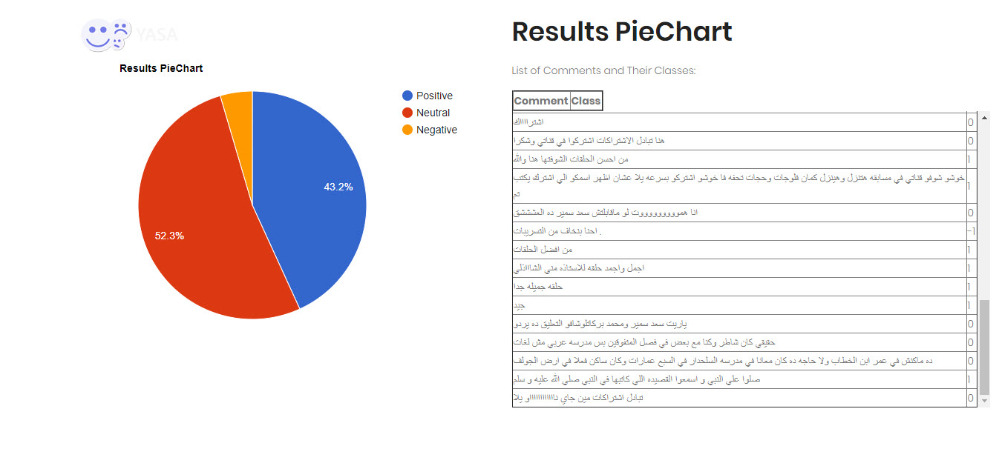
Results

Slide 20
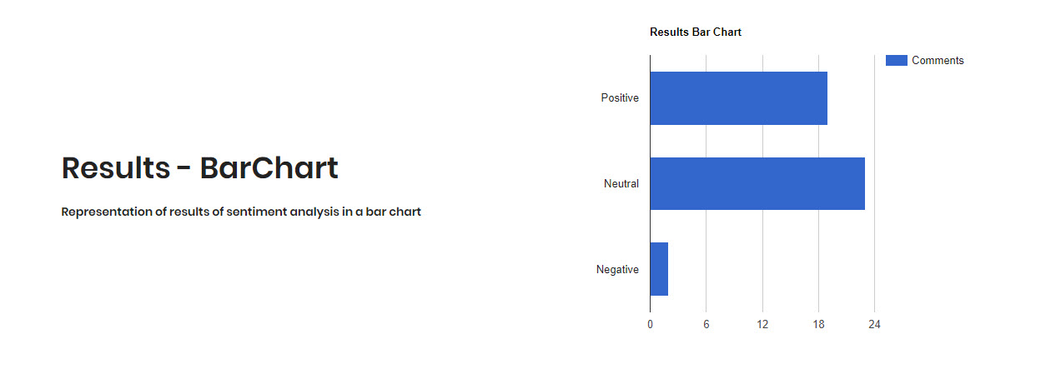
Results

Slide 21
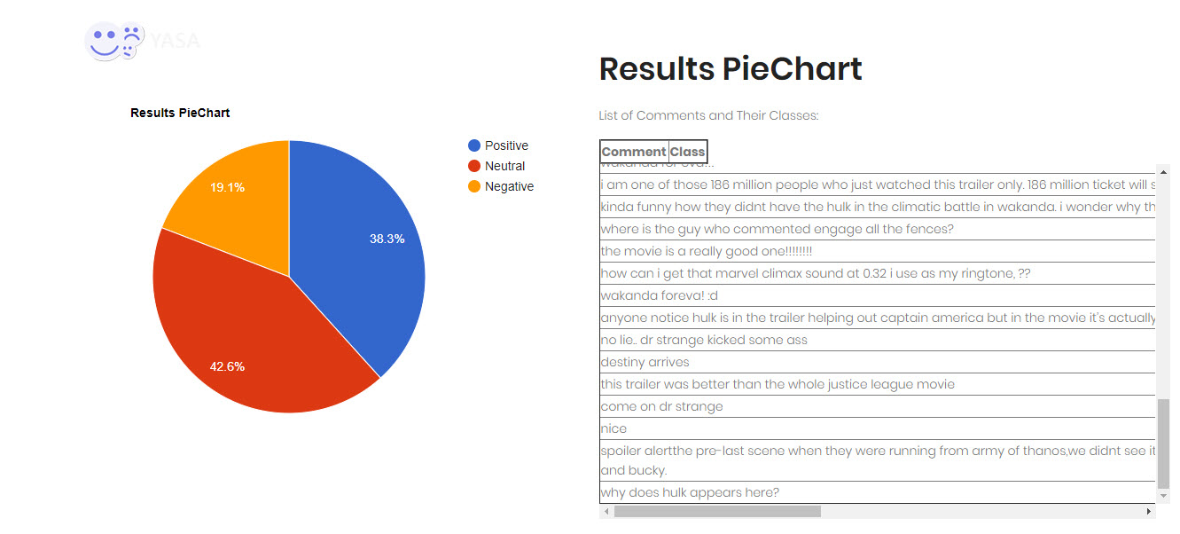
Results

Slide 22
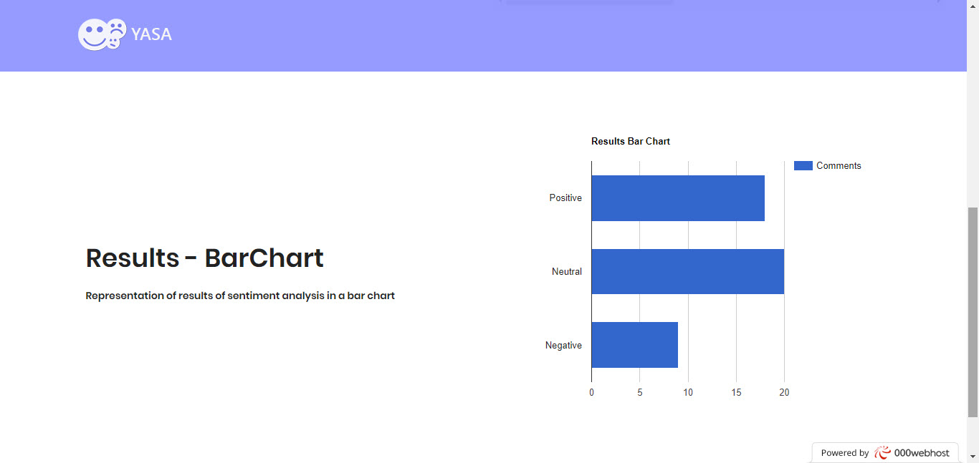
Results

Slide 23
Conclusion
Sentiment Analysis is a long process which involves different NLP processes and techniques.
Improving Accuracy of Sentiment Analysis System can be investigated through different blocks of whole process.

Slide 24
Further Improvement
Vertical Improvement (Long Run Process): - Using different Lexicons. - Using better Normalization techniques (Especially in Arabic). - Trying different ML algorithms with more parameters for Model Builder. - Collecting Larger Datasets with wider domains for model builder with different type of features. - Trying different weight calculation approaches for Lexicon Approach.
Horizontal Improvement: - Use different social media services other than YouTube. - Support more languages.

Slide 25
Acknowledgment

Slide 26
References
Emotional-Tone-Dataset: https://github.com/AmrMehasseb/Emotional-Tone/blob/master/Emotional-Tone-Dataset.csv
‘Sentiment Analysis in Arabic: a Literature Review’ made by Naaima Boudad in 2016 https://www.sciencedirect.com/science/article/pii/S2090447917300862
youtube API Documentation https://developers.google.com/youtube/
GooglTrans API for using Google Translate https://pypi.python.org/pypi/googletrans
NileULex Lexicon https://github.com/NileTMRG/NileULex
Hu and Lei English Lexicon https://github.com/woodrad/Twitter-SentimentMining/tree/master/Hu%20and%20Liu%20Sentiment%20Lexicon

Slide 27
References
7) Sentiment Analysis in Arabic tweets Rehab M. Duawiri in 2014, https://www.researchgate.net/publication/271550479_Sentiment_Analysis_in_Arabic_tweets
8) SENTIMENT ANALYSIS FOR ARABIC AND ENGLISH DATASETS By R.M. Elawady in 2015,
https://www.researchgate.net/publication/281276441_SENTIMENT_ANALYSIS_FOR_ARABIC_AND_ENGLISH_DATASETS
9) Arabic / English Sentiment Analysis: An Empirical Study By Mohammed K. Alkabi et al. in 2013, https://www.researchgate.net/publication/236833290_Arabic_English_Sentiment_Analysis_An_Empirical_Study

Slide 28

Thank You

